Slide 1















BW on HANA without HA
Azure Datacenter US East 2
2
AD,
Monitoring, Backup Server, SAP Router in VM
Express Route 99.95% SLA
1.2 TB (Backup) x (30 (daily) + 12 (monthly) + 3 (yearly)) generations (Long term)
[1.2 X 30 + 1.2 * 12 + 1.2 *3] = ~54 TB
6
1.2 TB (Backup) x 3 generations (Short term)
on 4 x P30 disks
1
5
Backup Vault
SSD
GW Subnet
Subnet #1 MGMT
ER
Standard Storage
Premium Storage
Subnet #3 PRD – DB
Subnet #2 PRD APPL
M128s
Availability Set
HANA Database
ExpressRoute Gateway
E8_v3
E8_v3
3
MPLS WAN
APPL servers in Availability Set
2 x E8_v3
SAPS 17,512
VM type : 1 x M128s (128-core, 2TB RAM)
VM uptime SLA : 99.9%
Data: 2 x P30 disks (1 TB/200MBs)
Total/Stripe = 2TB, 400 MB/s Throughput
Log: 2 x P15 disk (256 GB/125MBs)
Total/Stripe = 512 GB, 250 MB/s Throughput)
Shared: 1 x P30 disk (1TB/200MBs)
Customer Corporate Network
4
Dev
Test
QA
7
Turn on Dev/Test servers only when needed
QA: VM type : M64s, Storage
Data: 1 x P30. Log: 1 x P20, Shared: 1 x P30
DEV, TST VM type : 2 x E32v3, Storage per VM
Data: 1 x P15, Log: 1 x P10, Shared: 1 x P15
Subnet #4
non-PRD
Azure Virtual
Network
E32v3
E32v3
M64s
ERP
ERP
Notes:
Let us start with the Business Warehouse on HANA implemented by using Azure virtual machines without High Availability provisions
As you can see, we have a cross premises scenario, with the customer’s on-premises corporate network and an Azure datacenter in the East US region. The customer has already standard storage, which will allow us to also deploy the authentication, backup, and monitoring infrastructure.
For cross-premises connectivity, we leverage the MPLS-based ExpressRoute circuit that already exists between the customer’s network and a virtual network in the US East Azure region. This will allow us to extend our on-premises Active Directory by deploying Azure virtual machines and promoting them to become additional domain controllers in the existing on-premises domain.
We start by deploying a M128s size VM that will serve the role of the HANA DB production server and provision premium storage managed disks to contain the HANA data files, log files and shared (install) directory. We size storage according to our customer requirements and following TDI/storage best practice, with 2 x P30 disks for data files (Sizedata = 1 x RAM), each providing 1 TB of storage and 5,000 IOPS, striped yielding the a total of 2TB capacity, 400MB/s throughput and 10,000 IOPS. We also add four P10 disks, striped to facilitate 512 GB capacity, 400MB/s throughput and 2000 IOPS - sufficient to accommodate the HANA log files. Finally, we deploy 1 x P30 disk for the HANA shared/install directory. With the HANA DB virtual machine in place, we next provision a pair of virtual machines that will serve as the ASCS and the application server. According to customer requirements, the Business Warehouse application servers must be able to handle about 10,000 SAPS. Two D12v2s are rated at 6,680 each, giving us total of 13,360 SAPS. You might want to verify that these ratings yield the application severs operating at acceptable utilization levels, since some of the ratings represent SAPS at close to 100% server utilization. However, for the most part, this applies to scenarios that involve two tier architecture or the database tier in the three-tier architecture, which is not the case here.
We also use a M128s and a pair of E32v3s to build a two-tier QA, development and test environment. QA is a built as a database copy of PRD, therefore the following disks are attached, two P30s (data), four P10 (log) and one P30 shared(install). For DEV & TSTS - 2 P10s (data), 1 P10 (log), 2 P10 (shared)
Next, we implement a couple of Azure virtual machines to provide backup and monitoring functionality. The backup VM supports premium storage, which provides high performance and sufficient capacity with two P30 disks. For long term backups, we offload content of the local disks on the backup server to the Azure Backup vault.

Slide 2
BW on HANA with HA
Azure Datacenter US East 2
2
AD,
Monitoring, Backup Server, SAP Router in VM
Express Route 500Mbit/s
99.95% SLA
1.2 TB (Backup) x (30 (daily) + 12 (monthly) + 3 (yearly)) generations (Long term)
[1.2 X 30 + 1.2 * 12 + 1.2 *3] = ~54 TB
7
1.2 TB (Backup) x 3 generations (Short term)
on 4 x P30 disks
1
6
Backup Vault
SSD
Availability Set
GW Subnet
Subnet #1 MGMT
Standard Storage
Premium Storage
Subnet #3 PRD – DB
ExpressRoute Gateway
M128s
M128s
HANA HA Pair
System Replication/sync
Availability Set
Availability Set
Subnet #2 PRD – ASCS +APPL
3
MPLS WAN
ASCS
Linux HA Cluster
E2_v3
E2_v3
E8_v3
E8_v3
VM type : 2 x M128s (128-core, 2TB RAM)
VM uptime SLA : 99.95%
Data (x2): 2 x P30 disks (1 TB/200MBs)
Total/Stripe = 2TB, 400 MB/s Throughput
Log (x2) : 2 x P15 disk (256 GB/125MBs)
Total/Stripe = 512 GB, 250 MB/s Throughput)
Shared (x2): 1 x P30 disk (1TB/200MBs)
Customer Corporate Network
Availability Set NFS Share
APPL servers in Availability Set
2 x E8_v3
SAPS 17512
5
4
Highly available SAP ASCS and NFS on Linux Clusters
VM uptime SLA : 99.95%
2 x E2_v3
Dev
Test
QA
8
Turn on Dev/Test servers only when needed
QA: VM type : M64s, Storage
Data: 1 x P30. Log: 1 x P20, Shared: 1 x P30
DEV, TST VM type : 2 x E32v3, Storage per VM
Data: 1 x P15, Log: 1 x P10, Shared: 1 x P15
Subnet #4
non-PRD
Azure Virtual
Network
E32v3
E32v3
M64s
ERP
ERP
Notes:
Now let us extend our first solution by incorporating high availability provisions. To accomplish this, we deploy another M128s virtual machine in the same availability set as the first HANA DB virtual machine and set up HANA system replication between the two.
We also deploy a pair of virtual machines into the application tier and use Windows Failover clustering with shared storage emulated by SIOS Datakeeper to provide high-availability of the ASCS components. We also provide high availability by virtue of having two application servers in the same availability set.
To account for users that rely on SAP Fiori or PowerBI to interact with Business Warehouse on HANA and S/4 HANA we deploy a pair of virtual machines that host the relevant server side components, including Enterprise Portal and Power BI Enterprise Gateway.

Slide 3




S/4HANA, BW on HANA, HANA Enterprise, Side Car – VM with HA/DR
Azure Datacenter East US 2
Frontend ExpressRoute between customer and Azure VM recommended
Azure Virtual Network #1
1
GW Subnet
Subnet #1 – AP Prod
Subnet #2 – DB Prod
Subnet #3 Mgmt
Premium Storage
SSD
HANA Database Server(s) Prod
Availability Set
Backup Vault
ER
Availability Set
Security Center
ExpressRoute Gateway High Perf 2Gbps
Operation Mgmt Suite
2
5
2 nodes x 448GB (RAM) HANA System Replication Cluster uptime SLA : 99.95% 2TB SSD Storage
2 nodes x 4-core SAP app server cluster – uptime SLA : 99.95%
HANA System Replication for async volume replica
MPLS WAN
3
4
Customer Corporate Network
Azure Datacenter West US
Azure Virtual Network #2
Premium Storage
GW Subnet
Subnet #4 – AP DR
Subnet #5 – DB DR
Subnet #6 Mgmt
SSD
HANA Database Server(s) DR
Backup Vault
Security Center
Turn off VMs after setup (then Compute NOT charged)
Operation Mgmt Suite
6

Slide 4
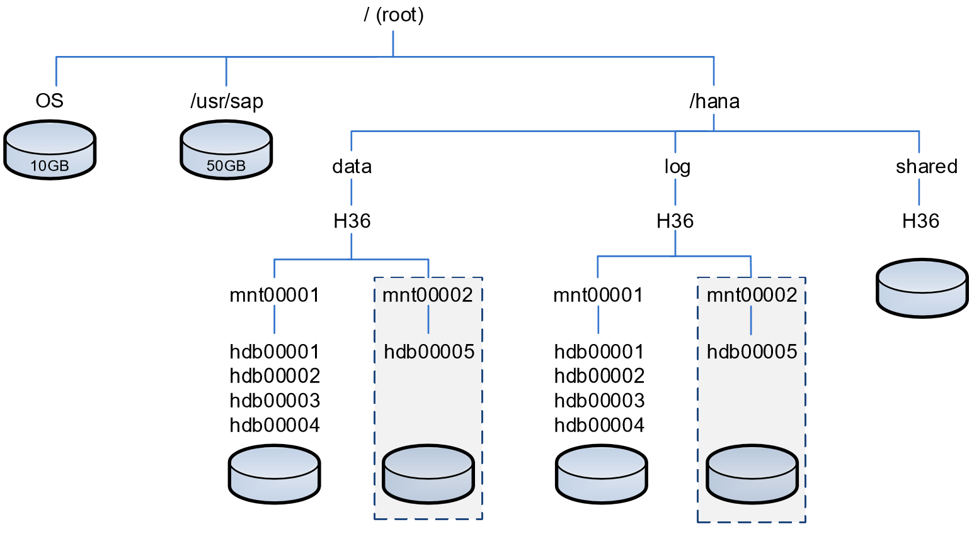
SAP HANA Storage Layout (TDI Best Practice)
Size Data =
1.2 x net data size on disk or 1 x RAM
Size Log =
1/2 x RAM [systems ≤ 512GB]
or
Size Log(min) =
512GB [systems > 512GB]
Size Shared (single-node) =
MIN(1 x RAM; 1 TB)
**Important**
Disk striping required to reach production throughput KPIs for VM/storage
VM disk cache = none, for
/hana/data and /hana/log
Source SAP - SAP HANA Storage Requirements
Notes:
Best practice for sizing persistence (storage) for SAP HANA.

Slide 5
Downtime Minimized Migration (DMO/SUM) to Azure/HANA
DMO with System Move
– change PAS host during DMO
Source SAP: DMO/SUM 1.0 SP21 Guide (source PAS must be UNIX/LINUX based)
Notes:
Downtime minimized migration to HANA via DMO/SUM – system move. Source primary application server (PAS) must be UNIX/LINUX based.

